Slide 1

Fake News Classification
James Olmstead

Slide 2
Table of Contents
Introduction
Data
Cleaning
Preprocessing
Vectorization
Initial Exploratory Analysis
Model
Analysis/Results
Conclusion

Slide 3
Introduction
Can we use natural language processing to predict veracity of news articles?
Data is from Kaggle competition: https://www.kaggle.com/c/fakenewskdd2020/overview
Train set
Test set
Sample Submission
Mostly Celebrity Gossip

Slide 4
Data Cleaning
Data didn’t require much cleaning
.csv problem – solved by .txt

Slide 5
Data Preprocessing
Breaking the texts down into simpler components
Convert to lower case (Jack -> jack)
Remove special characters (!?./)
Remove stop words (the, or, of)
Apply stemmer (going, goes -> go)
Before: Much like a certain Amazon goddess with a lasso, there are no heights that director Patty Jenkins can’t scale.
After: much like certain amazon goddess lasso height director patti jenkin scale

Slide 6
Data Vectorization
Process of converting text to numbers
Sentence 1: The dog is red
Sentence 2: The cat is blue
Sentence 3: Is the dog blue?
Reality is a bit more complicated
Vectorization | blue | cat | dog | is | red | the
Sentence 1 | 0 | 0 | 1 | 1 | 1 | 1
Sentence 2 | 1 | 1 | 0 | 1 | 0 | 1
Sentence 3 | 1 | 0 | 1 | 1 | 0 | 1

Slide 7
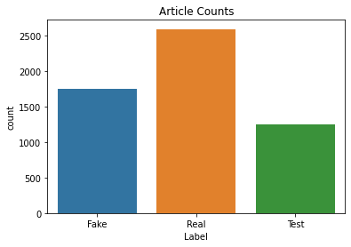
Initial Analysis

Slide 8
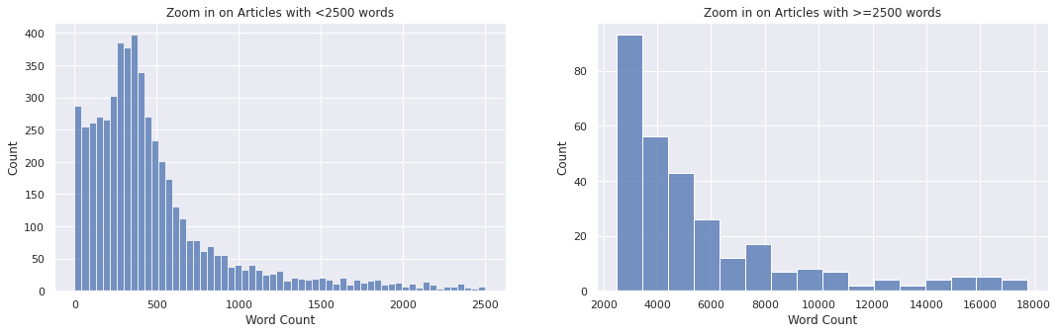
Initial Analysis

Slide 9
The Model
Multinomial Naive Bayes
Easy to implement
Most commonly used in NLP classification problems
Not as accurate as some others
Parameter Selection
Cross-validated grid search

Slide 10
The Model
Feature Selection
Cut words with lowest Chi-squared statistic
Index | Word | chi2 | p
5932 | brad | 3.520526e+01 | 2.967212e-09
27185 | pitt | 3.176604e+01 | 1.739074e-08
32729 | sourc | 2.094737e+01 | 4.720760e-06
18943 | joli | 1.898240e+01 | 1.319295e-05
3229 | angelina | 1.717027e+01 | 3.417432e-05

Slide 11
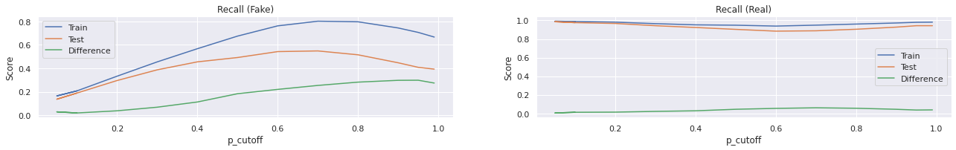
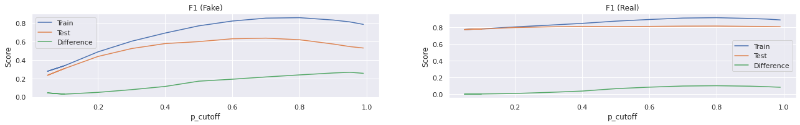
Feature Selection cont.
My cutoff
p=.7

Slide 12
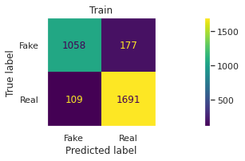
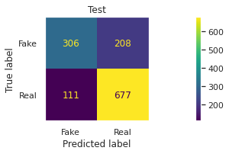
Model Results
Pretty good on training data
Not as good on test data

Slide 13
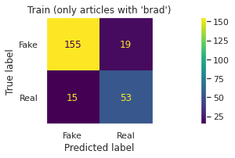
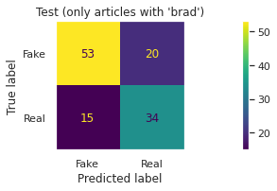
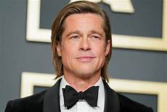
Model Results (Brad Pitt)
Highest Chi-squared value
Lots of Fake news about Brad Pitt!

Slide 14
Model Results Final
The model generated a score of 0.75344
#19 on the Kaggle leaderboard.

Slide 15
Conclusion
Pleased about the process, but not the result
Try new algorithms (random forest, logistic regression, etc.
Add named entity recognition

